Slide 1
Playfair Cipher Project
Team id: 106
Members:
Youssef Ayman Omar
Youssef Wasseem Youssef
Youssef Khaled ahmed
Project ta: Dr. Mona sadik
Section: 20 (All members)

Slide 2
PROCEDURES
1) ReadAFile PROC:-
Explanation:
This Procedure Is Used To Get The Contents Of A .txt File And Stores Them Into Two Variables Called "key" And "message," Which Are To Be Used In Encryption Or Decryption
Input:
Takes “filename1”, “buffer”, ‘fileHandle”, “key”, “keycount”, “message”, And “messagecount” Variables.
Uses All 32-bit Registers
Output:
Returns The Encryption Key In The “key” Variable, And Its Size In The “keycount” Variable. Returns The Message To Be Encrypted In The “message” Variable, And Its Size In The “messagecount” Variable.

Slide 3
PROCEDURES
2) WriteAFile PROC:-
Explanation:
This Procedure Is Used To Save The Final Coded Message (Be It Encrypted Or Decrypted), Into A .txt File.
Input:
Takes “filename2”, “buffer”, “coded”, “messagecount” Variables.
Uses All 32-bit Registers
Output:
Saves The Content Of The "coded" Variable In The .txt File Stored In The Variable “filename2”.

Slide 4
PROCEDURES
3) GenerateTable PROC:-
Explanation:
This Procedure Is Used To Generate The Playfair Cipher Table, Which Is To Be Used In Encrypting Or Decrypting A Certain Message. The Table In Itself Is Stored In A Variable Called "CipherTable“.
Input:
Takes “CipherTable”, “KeyStr”, “KeyCount”, “LetterHolder”, “IndexHolder”, “DuplicateCounter”, “row”, “col“ Variables.
Uses All 32-bit Registers.
Output:
Returns The Constructed Cipher Table In The "CipherTable" Variable.

Slide 5
PROCEDURES
4) OutputTable PROC [OPTIONAL]:-
Explanation:
This Procedure Is Used To Output The Contents Of The Cipher Table To Make Sure It Was Constructed Correctly.
Input:
Takes “CipherTable”, “row”, “col“ Variables.
Uses All 32-bit Registers.
Output:
Outputs The Content Of The Variable "CipherTable".

Slide 6
PROCEDURES
5) AdjustMessage PROC:-
Explanation:
This Procedure Is Used To Adjust The Message That Is To Be Encrypted By Removing All Spaces, Converting All Letters To Lowercase, Converting All "j"s To "i"s And Adding An "x" Between Any Repeated Subsequent Characters.
Input:
Takes “message”, “messagecount”, “Plaintext”, “PTCount”, Variables.
Uses All 32-bit Registers Except EBX.
Output:
Returns The Adjusted Message With No Spaces, No Uppercase Letters, And With Separated Duplicate Letters, All Stored In The "Plaintext" Variable, And Its Size Stored In The “PTCount” Variable.

Slide 7
PROCEDURES
6) AdjustMessage_ForDecryption PROC:-
Explanation:
This Procedure Is Used In Case Of Decryption. It Is The Same As The Normal “AdjustMessage” Procedure, Except For The Fact That We Don't Need To Separate Any Similar Letters With An "x".
Input:
Takes “message”, “messagecount”, “Plaintext”, “PTCount”, Variables.
Uses All 32-bit Registers Except EAX And EBX.
Output:
Returns The Adjusted Message With No Spaces, No Uppercase Letters, And With Separated Duplicate Letters, All Stored In The "Plaintext" Variable, And Its Size Stored In The “PTCount” Variable.

Slide 8
PROCEDURES
7) Encrypt PROC:-
Explanation:
This Procedure Is Used To Encrypt The Message Using The Playfair Cipher Technique.
Input:
Takes “CipherTable”, “Plaintext”, “PTCount”, “row”, “col”, “rowIndex”, “colIndex” Variables.
Uses All 32-bit Registers.
Output:
Returns The Encrypted Message Stored In The "Plaintext" Variable, And Its Size Stored In The "PTCount" Variable.

Slide 9
PROCEDURES
8) Decrypt PROC:-
Explanation:
This Procedure Is Used To Decrypt The Message Using The Playfair Cipher Technique. It's The Same As The Encryption Procedure, Except The Encryption Rules Are Inversed To Decrypt A Given Word.
Input:
Takes “CipherTable”, “Plaintext”, “PTCount”, “row”, “col”, “rowIndex”, “colIndex” Variables.
Uses All 32-bit Registers.
Output:
Returns The Decrypted Message Stored In The "Plaintext" Variable, And Its Size Stored In The "PTCount" Variable.

Slide 10
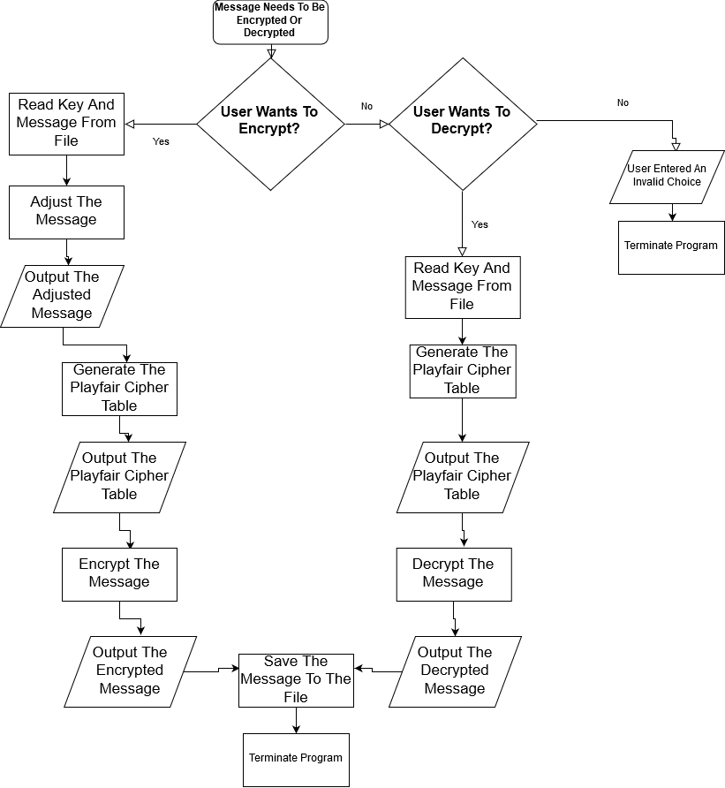
FLOWCHART

